Slide 1
Apache Spark on Amazon EMR
Saravanan Prabhagaran
Sr. Solutions Architect Database & Analytics
12/11/19

Slide 2
Agenda
Introduction to Apache Spark
Spark on Amazon EMR
Tuning best practices

Slide 3

FAST
RICH

Slide 4
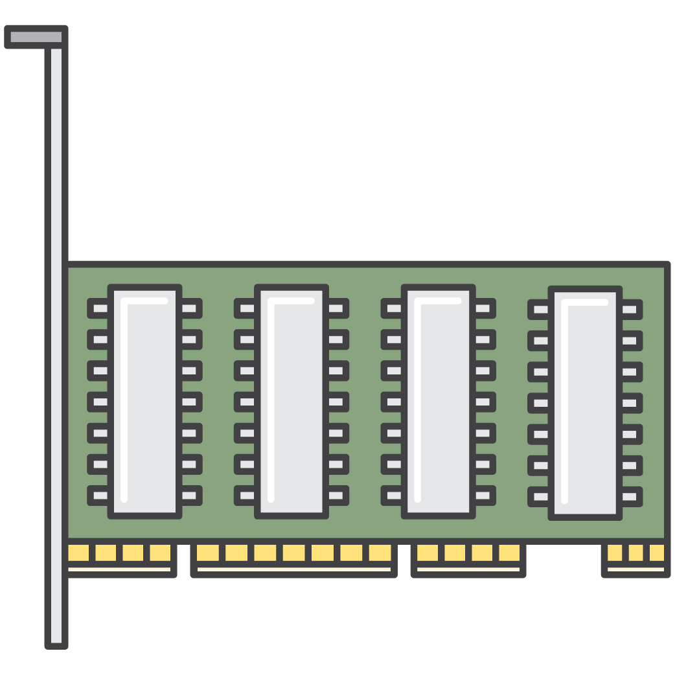
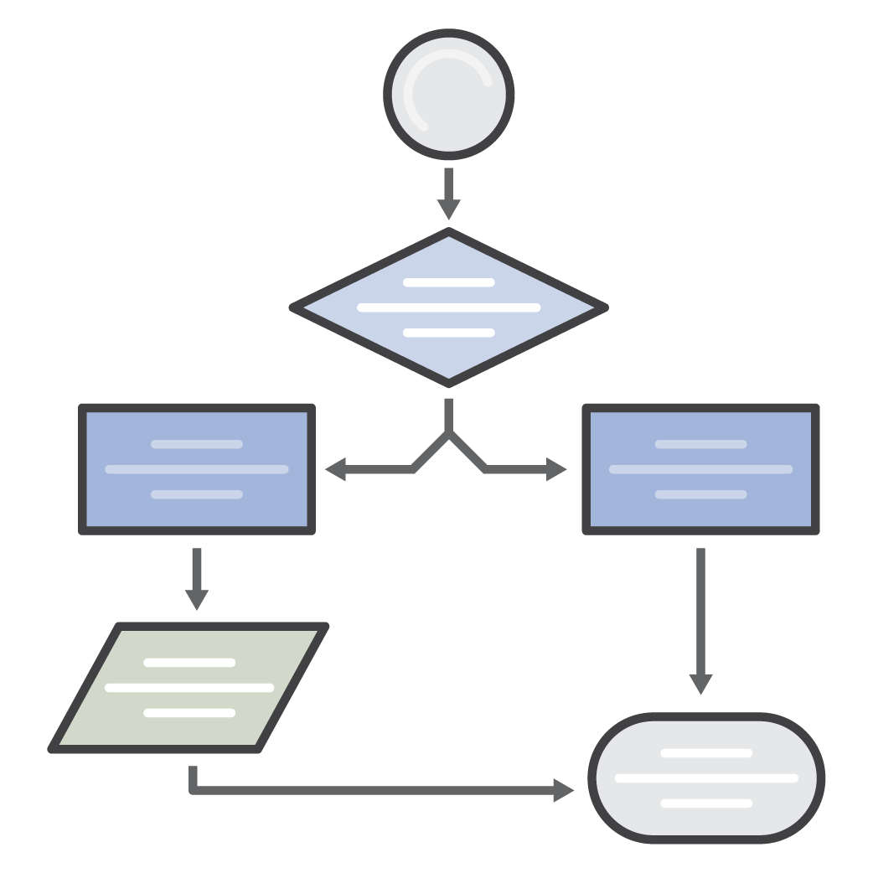
Fast
Memory
Processing

Slide 5
Rich
Spark
SQL
Spark/Structured Streaming
Spark
R
Spark
ML
Graph X
Spark Core

Slide 6








Spark Core
Notes:
Spark natively supports applications written in Scala, Python, and Java. It also includes several tightly integrated libraries for SQL (Spark SQL), machine learning (MLlib), stream processing (Spark Streaming), and graph processing (GraphX). These tools make it easier to leverage the Spark framework for a wide variety of use cases.

Slide 7
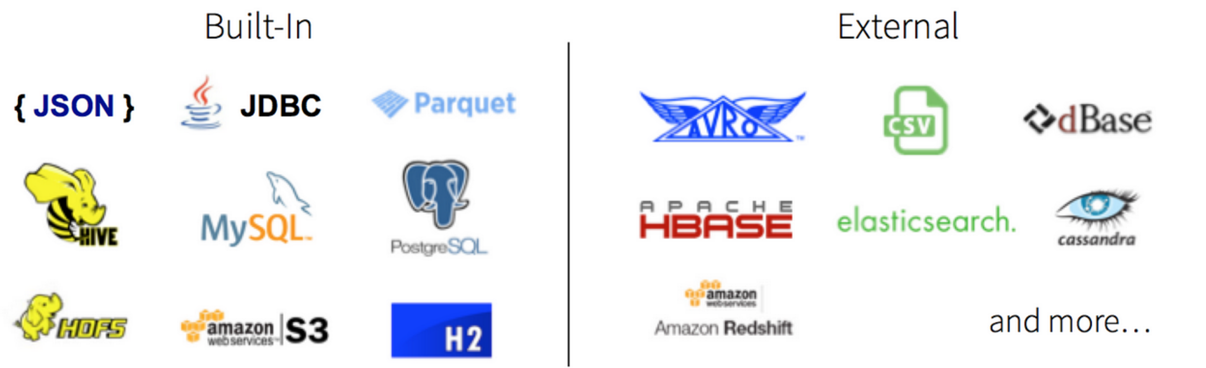
Spark Core
Connectors

Slide 8
Spark
SQL
Spark Streaming
Spark
R
Spark
ML
Graph X
Spark Core

Slide 9
Spark SQL
SQL
Notes:
Spark SQL is Apache Spark's module for working with structured data.
Hive Integration
Run SQL or HiveQL queries on existing warehouses.
Spark SQL supports the HiveQL syntax as well as Hive SerDes and UDFs, allowing you to access existing Hive warehouses.
DataFrames and SQL provide a common way to access a variety of data sources, including Hive, Avro, Parquet, ORC, JSON, and JDBC.

Slide 10
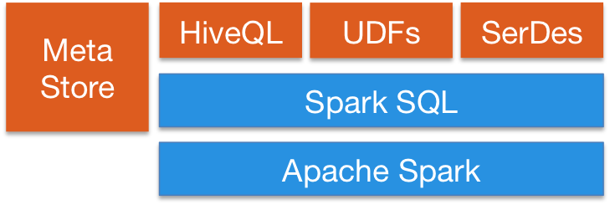
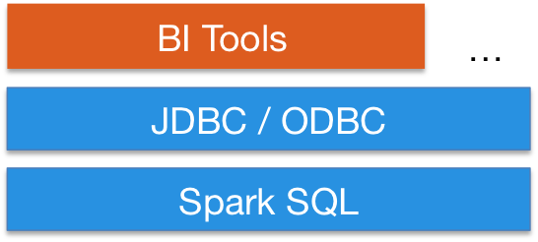
SQL
Spark SQL
https://spark.apache.org/images/sql-hive-arch.png
https://spark.apache.org/images/jdbc.png
Notes:
Spark SQL is Apache Spark's module for working with structured data.
Hive Integration
Run SQL or HiveQL queries on existing warehouses.
Spark SQL supports the HiveQL syntax as well as Hive SerDes and UDFs, allowing you to access existing Hive warehouses.
DataFrames and SQL provide a common way to access a variety of data sources, including Hive, Avro, Parquet, ORC, JSON, and JDBC.

Slide 11
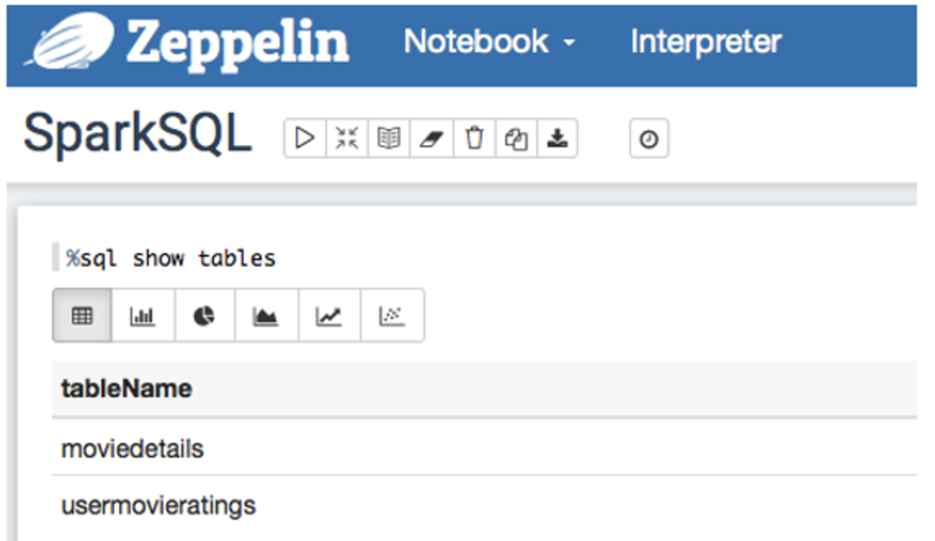
Spark SQL
BI Tool
SQL Editor
select movie-name, avg(rating) r
from moviedetails
group by movie-name
order by r desc
limit 10;
CLI

Slide 12
Spark
SQL
Spark/Structured Streaming
Spark
R
Spark
ML
Graph X
Spark Core

Slide 13



Streaming
Amazon
Kinesis
Apache
Kafka
Micro
Batches
Stream
Results
Structured Streaming

Slide 14
Spark
SQL
Spark Streaming
Spark
R
Spark
ML
Graph X
Spark Core

Slide 15

Spark R
Notes:
SparkR is an R package that provides a light-weight frontend to use Apache Spark from R.
In Spark 2.3.1, SparkR provides a distributed data frame implementation that supports operations like selection, filtering, aggregation etc. (similar to R data frames, dplyr) but on large datasets. SparkR also supports distributed machine learning using MLlib.

Slide 16
Spark
SQL
Spark Streaming
Spark
R
MLlib/
Spark
ML
Graph X
Spark Core
Notes:
MLlib is Spark’s machine learning (ML) library. Its goal is to make practical machine learning scalable and easy. At a high level, it provides tools such as:
ML Algorithms: common learning algorithms such as classification, regression, clustering, and collaborative filtering
Featurization: feature extraction, transformation, dimensionality reduction, and selection
Pipelines: tools for constructing, evaluating, and tuning ML Pipelines
Persistence: saving and load algorithms, models, and Pipelines
Utilities: linear algebra, statistics, data handling, etc.

Slide 17
Spark ML
70%
Data Prep
Split
Train
Test
30%
Training Data
SQL
ML
Model
Prediction
Near Real-time Data

Slide 18
Spark
SQL
Spark Streaming
Spark
R
Spark
ML
Graph X
Spark Core

Slide 19
Graph X
A
Relationship
B
Graph Databases (OLTP) | Graph Processors (OLAP)
Neo4J | GraphX
OrientDB | Giraph
C
D
E

Slide 20
Apache Spark on Amazon EMR

Slide 21
Launching a cluster with Spark
// CLI
aws emr create-cluster --name "Spark cluster" --release-label emr-5.16.0 --applications Name=Spark \ --ec2-attributes KeyName=myKey --instance-type m4.large --instance-count 3 --use-default-roles
// SDK
AmazonElasticMapReduceClient emr = new AmazonElasticMapReduceClient(credentials);
Application sparkApp = new Application().withName("Spark");
Applications myApps = new Applications();
myApps.add(sparkApp);
RunJobFlowRequest request = new RunJobFlowRequest().withName("Spark Cluster") .withApplications(myApps).withReleaseLabel("emr-5.16.0").withInstances(new JobFlowInstancesConfig().withEc2KeyName("myKeyName").withInstanceCount(1) .withKeepJobFlowAliveWhenNoSteps(true).withMasterInstanceType("m4.large") .withSlaveInstanceType("m4.large") );
RunJobFlowResult result = emr.runJobFlow(request);

Slide 22
Using Glue Data Catalog as metastore for Spark SQL
Configure Glue Data Catalog as metastore for Spark SQL (EMR ver > 5.8)
Persistent metastore – shared by different clusters, services, applications
Considerations
Renaming tables from within Glue – not supported
Column statistics, Hive authorization, Hive constraints, Cost based optimization in Hive are not supported
Partition values with quotes or apostrophe not supported
No UDFs in query predicates
Temporary tables not supported

Slide 23
Configuring Spark
Configuration classifications for Spark on Amazon EMR include the following:
spark—Sets the maximizeResourceAllocation property to true or false. When true, Amazon EMR automatically configures spark-default properties based on cluster hardware configuration. For more information, see Using maximizeResourceAllocation.
spark-defaults—Sets values in the spark-defaults.conf file. For more information, see Spark Configuration in the Spark documentation.
spark-env—Sets values in the spark-env.sh file. For more information, see Environment Variables in the Spark documentation.
spark-hive-site—Sets values in the hive-site.xml for Spark.
spark-log4j—Sets values in the log4j.properties file. For settings and more information, see the log4j.properties.template file on Github.
spark-metrics—Sets values in the metrics.properties file. For settings and more information, see the metrics.properties.template file on Github, and Metrics in Spark documentation.
Notes:
Some of the configuration classifications for Spark running on EMR.

Slide 24
Configuring Spark
Setting | Description | Value
spark.executor.memory | Amount of memory to use per executor process. (for example, 1g, 2g) | Setting is configured based on the slave instance types in the cluster.
spark.executor.cores | The number of cores to use on each executor. | Setting is configured based on the slave instance types in the cluster.
spark.dynamicAllocation.enabled | Whether to use dynamic resource allocation, which scales the number of executors registered with an application up and down based on the workload. | true (emr-4.4.0 or greater) Note Spark Shuffle Service is automatically configured by Amazon EMR.

Slide 25
Writing a Spark Application
// SCALA
package org.apache.spark.examples
import scala.math.random
import org.apache.spark._
/** Computes an approximation to pi */
object SparkPi {
def main(args: Array[String]) {
val conf = new SparkConf().setAppName("Spark Pi")
val spark = new SparkContext(conf)
val slices = if (args.length > 0) args(0).toInt else 2
val n = math.min(100000L * slices, Int.MaxValue).toInt // avoid overflow
val count = spark.parallelize(1 until n, slices).map { i =>
val x = random * 2 - 1
val y = random * 2 - 1
if (x*x + y*y < 1) 1 else 0
}.reduce(_ + _)
println("Pi is roughly " + 4.0 * count / n)
spark.stop()
}
}

Slide 26
Submitting Spark jobs
EMR Step API (Console, CLI, SDK)
Spark-submit script

Slide 27
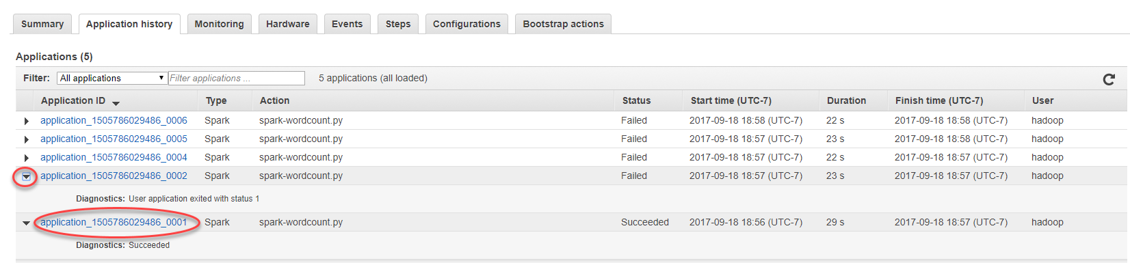
View Spark application History

Slide 28
Spark Web UI
Establish SSH tunnel
Navigate to YARN RM for your cluster.
Choose ‘Tracking UI’
Spark application driver's web UI at port 4040
Spark HistoryServer UI at
http://master-public-dns-name:18080/.

Slide 29
Optimizations in Spark

Slide 30
Tricks and tips
Use newer versions of Spark
Avoid RDDs
Cache and reuse results
Use Parquet format for saving and loading data
Partitions your inputs and outputs
Avoid shuffling and repartitioning
Notes:
Use dataframes/datasets instead. Several books and articles show that dataframes/datasets are orders of magnitude faster than RDDs. They also consume less memory. The only reasons to use an RDD is if some specific functionality is only supported in RDDs or if some library requires RDDs. As new Spark versions are released there are fewer and fewer examples of functionality that is only available in RDDs.
assumes that you are reading or writing big data from an external storage like S3. If the input for your job is one big file (compressed) there might be no way to parallelize reading of the data in the Spark job. Usually, Spark will create one task for each input split (file). When reading the input data you want to make sure all the executors are participating. S3 is surprisingly slow at downloading one file (there is an undocumented limit for the S3 download speed per thread), so downloading multiple files in parallel is a huge boost.
If you use KMS to encrypt the files and you have a lot of files you may spend a lot of time calling KMS and you may also get into KMS throttling issues.
Shuffling and repartitioning are the most expensive operations in Spark.
If shuffling has to occur, make it at the beginning and end of your operations, rather than mid-way.

Slide 31
Tricks and tips
Pick the right instance types
If memory is a constraint, use m4 instances instead of c4 instances
Configure Spark correctly
default EMR configuration for Spark are very simplistic
For e.g., enable speculative execution
Enable/Disable Dynamic allocation based on workload
Minimize number of executor instances per machine
Avoid executors with too much memory
Number of active tasks = number of cores
Notes:
Since Spark operates mainly in memory you may want to have enough memory in your cluster to load the totality of the input data you need and the intermediate processing data. Instances like r3, r4 or i3 make good candidates. i3 is definitely better than r3.
If you plan on using HDFS, make sure you get enough disk space. Also, you may need disk space if you are going to persist datasets as that can spill on the disk.
eam runs one application at a time (mostly for simplicity and due to using EMR step API to start the Spark applications). For this case, the Spark dynamic allocation doesn't work great. It is slow to ramp up and it will not maximize the resource usage. It is better to disable the dynamic allocation and configure the rest of the parameters to maximize the resource usage.
2 reasons to keep the number of executors instances per machine small: reduce the chance that you'll run out of memory and faster shuffles.

Slide 32
Tricks and tips
Avoid ‘LIKE’ in SQL queries
Reduce data shuffles
Optimize joins
Avoid cross joins
Use broadcast join for smaller datasets
Use flatmap instead of broadcast join
Avoid spilling to disk
Detect and handle data skew
Notes:
a spark job took 9 hours. While profiling we discovered that most of the time during a join was spent doing regular expression work. Looking at the join query we noticed that one of the WHERE clauses was using LIKE to match the prefix of a column. It seems that Spark (at least 2.0.1. version) was not able to precompile the regular expressions in the LIKE.Replacing the LIKE with a UDF that did a startsWith reduced the duration of the job to 30 minutes.
This is a very popular "best practice" but probably the one that is the most misunderstood. In theory it makes total sense as shuffling data between machines takes time however it is hard to quantify the time spent on shuffling data. It is important to understand which transformations require a shuffle and which ones don't.
Shuffles are triggered by a repartition of the data (ex. when you group by a column or just call repartition). Sometimes, however, repartitioning your data can make your job or the jobs that consume data produced by your job faster by solving some of the data skew problems.
"the cross product of big data and big data is an out-of-memory exception" .

